Slide 1

Code Combat 3.0 (React)
Participant Name: Rajat M

Slide 2

Brief Summary of Project:
The project statement was to build a meme generator app using React.js
The user should be able to choose from a collection of meme images and text to it
There must be an option to add text to the top and to the bottom of the meme

Slide 3
Technology/Tool Stack Used:
Some of the technologies used in the development of this web application are as follow:
- React.js: A JavaScript library for building user interfaces.
Materialize CSS: A modern responsive front-end framework based on Material Design
html-to-image: Generates an image from a DOM node using HTML5 canvas and SVG.

Slide 4
Github URL for source code:
The Github link for the source code is:
https://github.com/Rajatm544/react-meme-generator

Slide 5
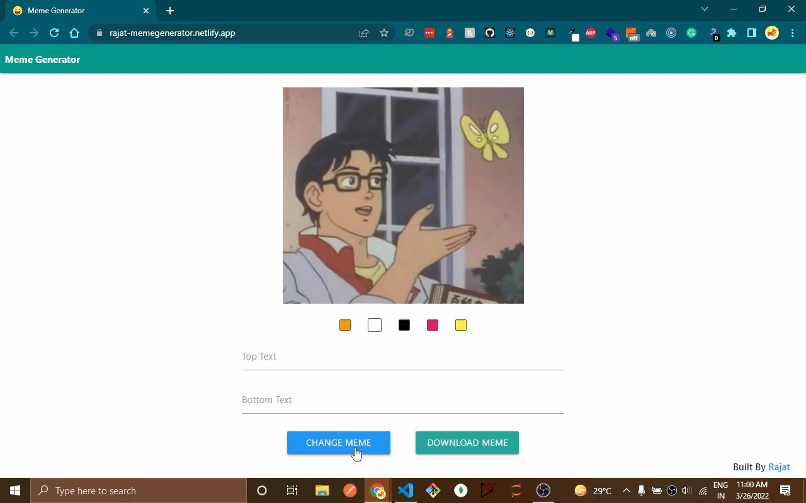
Screenshots/Video Demo of Application:
https://youtu.be/786s3io7nCs

Slide 6
Any Additional Information:
Few features about the app:
Allows user to choose from 100 different randomly selected memes.
There is an option to download the meme after adding text.
There is a color picker to choose text color.
The app has a custom favicon.
The app has been deployed to Netlify using CD from Github repo.
The README on the repo has more information!
Click here to check out this app.

Slide 7
Thank You

